Slide 1

DIGITAL DESIGN AND COMPUTER ORGANIZATION
Machine Instructions and Programs
Department of Computer Science and Engineering

Slide 2
DIGITAL DESIGN AND COMPUTER ORGANIZATION
Input/Output Organisation T2:Ch4 4.1,4.2 (except 4.2.4)
Department of Computer Science and Engineering

Slide 3
Basic Structure of computers Outline
Input/Output Organisation
Accessing I/O Devices
Interrupts
Interrupt Hardware
Enabling and Disabling Interrupts
Handling Multiple Devices
Exceptions

Slide 4
DIGITAL DESIGN AND COMPUTER ORGANIZATION
Accessing I/O Devices T2:Ch4 4.1
Department of Computer Science and Engineering

Slide 5
Machine Instructions and Programs Accessing I/O Devices(Single bus arrangement)
Processor
Memory
Bus
I/O device 1
I/O de
vice
n
Multiple I/O devices may be connected to the processor and the memory via a bus.
Bus consists of three sets of lines to carry address, data and control signals.
Each I/O device is assigned an unique address.
To access an I/O device, the processor places the address on the address lines.
The device recognizes the address, and responds to the control signals.
Carl Hamacher, Zvonko Vranesic, Safwat Zaky, Computer Organization, 5th ed., McGraw Hill, 2002, Section 4.1.

Slide 6
Machine Instructions and Programs Accessing I/O Devices
Programmed I/O is a technique where the CPU is directly responsible for transferring data between I/O devices and memory.
Memory-Mapped I/O Devices are accessed like memory. CPU uses MOV, STORE, LOAD instructions. Both I/O devices and memory
share same address space
I/O-Mapped I/O Devices are accessed with special I/O instructions (IN, OUT).
Carl Hamacher, Zvonko Vranesic, Safwat Zaky, Computer Organization, 5th ed., McGraw Hill, 2002, Section 4.1.

Slide 7
Machine Instructions and Programs Accessing I/O Devices
I/O devices and the memory may share the same address space:
Memory-mapped I/O.
Any machine instruction that can access memory can be used to transfer data to or from an I/O device.
Ex: Move DATAIN,R 1 – reads the data from DATAIN and puts to processor register R0
Move R2,DATAOUT
Simpler software.
DATAIN- Address of input buffer
DATAOUT_ output data buffer of printer/monitor/any output device
Carl Hamacher, Zvonko Vranesic, Safwat Zaky, Computer Organization, 5th ed., McGraw Hill, 2002, Section 4.1.

Slide 8
Machine Instructions and Programs Accessing I/O Devices
I/O devices and the memory may have different address spaces(Intel architectures)
Special instructions to transfer data to and from I/O devices. (IN and OUT)
I/O devices may have to deal with fewer address lines.
I/O address lines need not be physically separate from memory address lines.
In fact, address lines may be shared between I/O devices and memory, with a control signal to indicate whether it is a memory address or an I/O address.
Carl Hamacher, Zvonko Vranesic, Safwat Zaky, Computer Organization, 5th ed., McGraw Hill, 2002, Section 4.1.

Slide 9
Machine Instructions and Programs Accessing I/O Devices
Address lines
Bus
Data lines
Control lines
Address
Control
Data &
I/O
decoder
circuits
status registers
interface
Input device
Carl Hamacher, Zvonko Vranesic, Safwat Zaky, Computer Organization, 5th ed., McGraw Hill, 2002, Section 4.1.

Slide 10
Machine Instructions and Programs Accessing I/O Devices
I/O device is connected to the bus using an I/O interface circuit which has:
- Address decoder, control circuit, and data and status registers.
Address decoder decodes the address placed on the address lines thus enabling the
device to recognize its address.
Data register holds the data being transferred to or from the processor.
Status register holds information necessary for the operation of the I/O device.
Data and status registers are connected to the data lines, and have unique addresses.
The Address decoder, the data & status register and the control circuitry required to coordinate I/O transfer constitute the Device’s interface circuit
Carl Hamacher, Zvonko Vranesic, Safwat Zaky, Computer Organization, 5th ed., McGraw Hill, 2002, Section 4.1.

Slide 11
Machine Instructions and Programs Accessing I/O Devices
Program-controlled I/O:
A status flag i,e SIN and SOUT is included in the interface circuit as part of the status register.
This flag is set to 1 when a char is entered at the keyboard and and set to 0 when the char is read by the processor .
Same for SOUT.
Carl Hamacher, Zvonko Vranesic, Safwat Zaky, Computer Organization, 5th ed., McGraw Hill, 2002, Section 4.1.

Slide 12
Machine Instructions and Programs Accessing I/O Devices
To review the concept, let us consider a example of I/O operations involving a keyboard and a display device.
The 4 regs involved in the data transfer operations are : DATAIN, DATAOUT, STATUS, CONTROL
STATUS reg contains two control flags SIN and SOUT and two flags KIRQ, DIRQ which are used in conjunction with interrupts
Carl Hamacher, Zvonko Vranesic, Safwat Zaky, Computer Organization, 5th ed., McGraw Hill, 2002, Section 4.1.

Slide 13
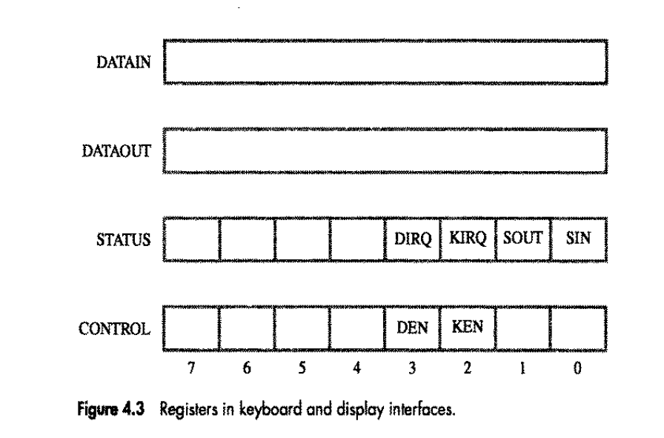
Carl Hamacher, Zvonko Vranesic, Safwat Zaky, Computer Organization, 5th ed., McGraw Hill, 2002, Section 4.1.
Notes:
D-display unit
K- Keyborad

Slide 14
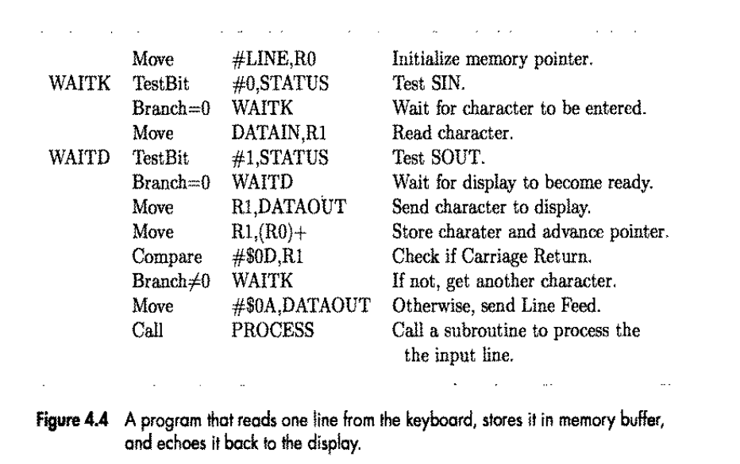
Carl Hamacher, Zvonko Vranesic, Safwat Zaky, Computer Organization, 5th ed., McGraw Hill, 2002, Section 4.1.
Notes:
CR (Carriage Return) - moves the cursor to the beginning of the current line. LF (Line Feed) - moves the cursor down to the next line

Slide 15
Machine Instructions and Programs Accessing I/O Devices
Recall that the rate of transfer to and from I/O devices is slower than the speed of the processor. This creates the need for mechanisms to synchronize data transfers between them.
Program-controlled I/O:
Processor repeatedly monitors a status flag to achieve the necessary synchronization.
Processor polls the I/O device.
Carl Hamacher, Zvonko Vranesic, Safwat Zaky, Computer Organization, 5th ed., McGraw Hill, 2002, Section 4.1.

Slide 16
Machine Instructions and Programs Accessing I/O Devices
Two other mechanisms used for synchronizing data transfers between the processor and memory:
Interrupts.
Direct Memory Access.
Carl Hamacher, Zvonko Vranesic, Safwat Zaky, Computer Organization, 5th ed., McGraw Hill, 2002, Section 4.1.

Slide 17
DIGITAL DESIGN AND COMPUTER ORGANIZATION
Interrupts
Department of Computer Science and Engineering

Slide 18
Machine Instructions and Programs Interrupts
In program-controlled I/O, when the processor continuously monitors the status of the device, it does not perform any useful tasks.
An alternate approach would be for the I/O device to alert the processor when it becomes ready.
Do so by sending a hardware signal called an interrupt to the processor.
At least one of the bus control lines, called an interrupt-request line is dedicated for this purpose.
Processor can perform other useful tasks while it is waiting for the device to be ready.
Carl Hamacher, Zvonko Vranesic, Safwat Zaky, Computer Organization, 5th ed., McGraw Hill, 2002, Section 4.2

Slide 19
Machine Instructions and Programs Interrupts
Whenever the printer becomes ready, it alerts the processor by sending an interrupt-request signal. In response, the processor interrupts execution of the COMPUTE routine and transfers control to the PRINT routine.
The PRINT routine sends the second line to the printer and is again suspended. Then the interrupted COMPUTE routine resumes execution at the point of interruption. This process continues until all n lines have been printed and the PRINT routine ends.
The PRINT routine will be restarted whenever the next set of n lines is available for printing. If COMPUTE takes longer to generate n lines than the time required to print them, the processor will be performing useful computations all the time.
Carl Hamacher, Zvonko Vranesic, Safwat Zaky, Computer Organization, 5th ed., McGraw Hill, 2002, Section 4.2

Slide 20
Machine Instructions and Programs Interrupts
Program
Interrupt Service routine
1
2
Interrupts occur here
i
i
+
1
M
Carl Hamacher, Zvonko Vranesic, Safwat Zaky, Computer Organization, 5th ed., McGraw Hill, 2002, Section 4.2

Slide 21
Machine Instructions and Programs Interrupts
Processor is executing the instruction located at address i when an interrupt occurs.
Routine executed in response to an interrupt request is called the interrupt-service routine.
When an interrupt occurs, control must be transferred to the interrupt service routine.
Carl Hamacher, Zvonko Vranesic, Safwat Zaky, Computer Organization, 5th ed., McGraw Hill, 2002, Section 4.2

Slide 22
Machine Instructions and Programs Interrupts
But before transferring control, the current contents of the PC (i+1), must be saved in a known location.
This will enable the return-from-interrupt instruction to resume execution at i+1.
Return address, or the contents of the PC are usually stored on the processor stack.
Interrupt request and interrupt acknowledgement
Carl Hamacher, Zvonko Vranesic, Safwat Zaky, Computer Organization, 5th ed., McGraw Hill, 2002, Section 4.2

Slide 23
Machine Instructions and Programs Comparision of Interrupts and Subroutine
Treatment of an interrupt-service routine is very similar to that of a subroutine.
However there are significant differences:
A subroutine performs a task that is required by the calling program.
Interrupt-service routine may not have anything in common with the program it interrupts.
Interrupt-service routine and the program that it interrupts may belong to different users.
Carl Hamacher, Zvonko Vranesic, Safwat Zaky, Computer Organization, 5th ed., McGraw Hill, 2002, Section 4.2

Slide 24
Machine Instructions and Programs Interrupt latency
Saving and restoring information can be done automatically by the processor
Saving and restoring registers involves memory transfers:
Increases the total execution time.
Increases the delay between the time an interrupt request is received, and the start of execution of the interrupt-service routine. This delay is called interrupt latency.
In order to reduce the interrupt latency, most processors save only the minimal amount of information:
This minimal amount of information includes Program Counter and processor status registers.
Any additional information that must be saved, must be saved explicitly by the program instructions at the beginning of the interrupt service routine.

Slide 25
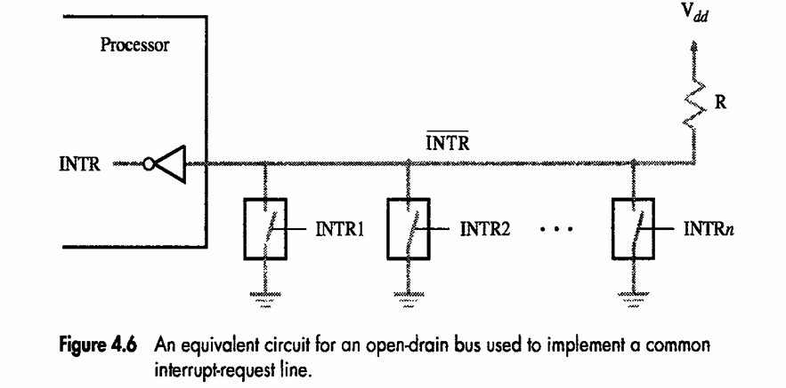
Machine Instructions and Programs Interrupt Hardware

Slide 26
Machine Instructions and Programs Interrupt Enable & Disable
Interrupt-requests interrupt the execution of a program, and may alter the intended sequence of events:
Sometimes such alterations may be undesirable, and must not be allowed.
Processors generally provide the ability to enable and disable such interruptions as desired.
One simple way is to provide machine instructions such as Interrupt-enable and Interrupt-disable for this purpose.
Edge triggered- processor will receive only one interrupt regardless of how long line is activated
Carl Hamacher, Zvonko Vranesic, Safwat Zaky, Computer Organization, 5th ed., McGraw Hill, 2002, Section 4.2

Slide 27
Machine Instructions and Programs Avoidance of successive interrupts
The interrupt request signal will be active until it learns that the processor has responded to its request. It is essential to ensure that this active signal does not lead successive interrupts.
Several mechanism are available to solve this problem:
The interrupt be disabled/enabled in the interrupt-service routine.
Carl Hamacher, Zvonko Vranesic, Safwat Zaky, Computer Organization, 5th ed., McGraw Hill, 2002, Section 4.2

Slide 28
Machine Instructions and Programs Avoidance of successive interrupts
The processor automatically disable interrupts before starting the execution of the interrupt-service routine.
The processor has a special interrupt request line through which it receives only one interrupt request regardless how long the line is activated.(Edge Triggered)
Carl Hamacher, Zvonko Vranesic, Safwat Zaky, Computer Organization, 5th ed., McGraw Hill, 2002, Section 4.2

Slide 29
Machine Instructions and Programs Interrupts
The sequence of events involved in handling an interrupt request from a single device :
The device raises an IR
The processor interrupt the program currently being executed.
Interrupts are disabled by changing bit in PS
The device is informed that its request has been recognized & in response, it deactivates the IR signal
The action requested by the interrupt is performed by ISR
Interrupts are enabled & execution of the interrupted program is resumed.
Carl Hamacher, Zvonko Vranesic, Safwat Zaky, Computer Organization, 5th ed., McGraw Hill, 2002, Section 4.2
Notes:
Ps-processor status register

Slide 30
Machine Instructions and Programs Handling Multiple Devices
Multiple I/O devices may be connected to the processor and the memory via a bus. Some or all of these devices may be capable of generating interrupt requests.
Each device operates independently, and hence no definite order can be imposed on how the devices generate interrupt requests?
How does the processor know which device has generated an interrupt?
How does the processor know which interrupt service routine needs to be executed?
When the processor is executing an interrupt service routine for one device, can other device interrupt the processor?
If two interrupt-requests are received simultaneously, then how to break the tie?
Carl Hamacher, Zvonko Vranesic, Safwat Zaky, Computer Organization, 5th ed., McGraw Hill, 2002, Section 4.2

Slide 31
Machine Instructions and Programs Handling Multiple Devices which device has generated an interrupt?
When a request is received over the common interrupt-request line, additional information is needed to identify the particular device that activated the line.
The additional information is available in its status register. KIRQ & DIRQ.
Then ISR polls all the I/O devices connected to the bus.
The first device with its IRQ bit set is the device that should be serviced.
Carl Hamacher, Zvonko Vranesic, Safwat Zaky, Computer Organization, 5th ed., McGraw Hill, 2002, Section 4.2

Slide 32
Machine Instructions and Programs Handling Multiple Devices
An appropriate subroutine is called to provide the request service.
The polling scheme is easy to implement , but it spends time in interrogating the IRQ bits of all the devices that may not be requesting any service.
An alternative approach is to use vectored interrupts.
Carl Hamacher, Zvonko Vranesic, Safwat Zaky, Computer Organization, 5th ed., McGraw Hill, 2002, Section 4.2

Slide 33
Machine Instructions and Programs Vectored Interrupts which interrupt service routine
To reduce the time involved in polling process, a device requesting an interrupt may identify itself directly to the processor.
Then the processor can immediately start executing the corresponding ISR.
A device requesting an interrupt can identify itself by sending a special code (4 to 8 bits)to the processor over the bus.
The code supplied by the device may represent the starting address of the ISR for that device.
Carl Hamacher, Zvonko Vranesic, Safwat Zaky, Computer Organization, 5th ed., McGraw Hill, 2002, Section 4.2

Slide 34
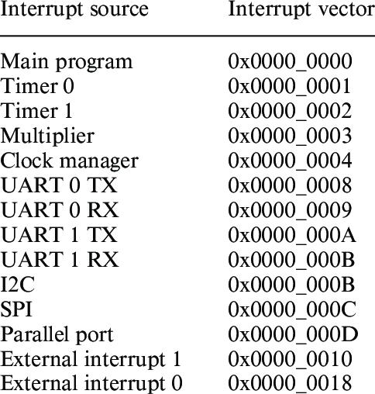
Machine Instructions and Programs Vectored Interrupts
This arrangement implies that the ISR for a given device must always start at the same location.
Flexibility can be provided by storing the starting address of the ISR in the location pointed to by the interrupting device
The processor reads this address, called the interrupt vector and loads it into the PC.
Carl Hamacher, Zvonko Vranesic, Safwat Zaky, Computer Organization, 5th ed., McGraw Hill, 2002, Section 4.2

Slide 35
Machine Instructions and Programs Vectored Interrupts
The interrupt vector may also include a new value for the processor status register.
When a device generates an interrupt request, the processor may not be ready to receive the interrupt_vector code immediately.
Ex. It must first complete the execution of current instruction which may require the use of bus
Carl Hamacher, Zvonko Vranesic, Safwat Zaky, Computer Organization, 5th ed., McGraw Hill, 2002, Section 4.2

Slide 36
Machine Instructions and Programs Vectored Interrupts
The interrupting device must wait to put data on the bus only when the processor is ready to receive it
When the processor is ready to receive the interrupt_vector code, it activates the interrupt_acknowledgement line, INTA.
The I/O device responds by sending the interrupt_vector code and de-activating the INTR signal.
Carl Hamacher, Zvonko Vranesic, Safwat Zaky, Computer Organization, 5th ed., McGraw Hill, 2002, Section 4.2

Slide 37
Machine Instructions and Programs Interrupt Nesting(other device raise interrupt )
The interrupts should be disabled during the execution of an ISR, to ensure that a request from one device will not cause more than one interruption.
This may delay in responding to an interrupt request from other devices.
For some devices, a long delay may lead to erroneous operation.
Ex. Processor Clock.
Carl Hamacher, Zvonko Vranesic, Safwat Zaky, Computer Organization, 5th ed., McGraw Hill, 2002, Section 4.2

Slide 38
Machine Instructions and Programs Interrupt Nesting
This example suggests that I/O devices should be organized in a priority structure.
An interrupt request from a high priority device should be accepted while the processor is servicing another request from a lower priority device.
To implement this scheme , we can assign a priority level to the processor that can be changed under program control.
Carl Hamacher, Zvonko Vranesic, Safwat Zaky, Computer Organization, 5th ed., McGraw Hill, 2002, Section 4.2

Slide 39
Machine Instructions and Programs Interrupt Nesting
The priority level of the processor is the priority of the program that is currently being executed.
This action disables interrupt from devices at the same level of priority or lower.
However, interrupt requests from higher priority devices will continue to be accepted.
Carl Hamacher, Zvonko Vranesic, Safwat Zaky, Computer Organization, 5th ed., McGraw Hill, 2002, Section 4.2

Slide 40
Machine Instructions and Programs Interrupt Nesting
The processor’s priority is usually encoded in a few bits of the processor status word.
This can be changed by privileged instructions, which are executed only while the processor is serving in the supervisor mode.
Carl Hamacher, Zvonko Vranesic, Safwat Zaky, Computer Organization, 5th ed., McGraw Hill, 2002, Section 4.2

Slide 41
Machine Instructions and Programs Interrupt Nesting
The processor is in the supervisor mode only when executing operating system routines.
It switches to the user mode before beginning to execute application programs.
Carl Hamacher, Zvonko Vranesic, Safwat Zaky, Computer Organization, 5th ed., McGraw Hill, 2002, Section 4.2

Slide 42
Machine Instructions and Programs Interrupt Nesting
If a user program accidentally or intentionally, changes the priority of the processor and disrupt the system operation, will lead to a special type of interrupt called a privilege exception.
Implementation of interrupt priority using individual interrupt-request & acknowledgement lines is as shown
Carl Hamacher, Zvonko Vranesic, Safwat Zaky, Computer Organization, 5th ed., McGraw Hill, 2002, Section 4.2

Slide 43
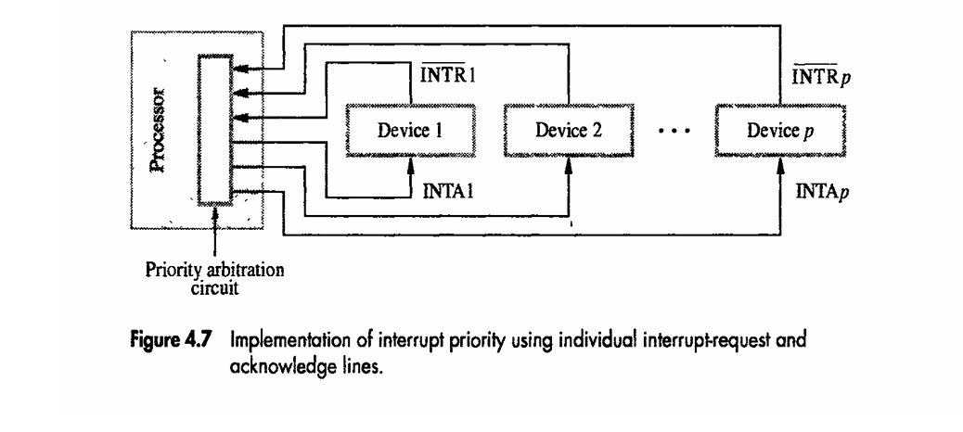
Machine Instructions and Programs Interrupt Nesting
Carl Hamacher, Zvonko Vranesic, Safwat Zaky, Computer Organization, 5th ed., McGraw Hill, 2002, Section 4.2
Notes:
Negation- signal is active when low voltage

Slide 44
Machine Instructions and Programs Simultaneous Requests
Consider the problem of simultaneous arrivals of interrupt requests from two or more devices.
The processor must have some means of deciding which request to service first.
If all the devices have individual interrupt-request lines then using a priority scheme, the processor accepts the request having the highest priority.
Carl Hamacher, Zvonko Vranesic, Safwat Zaky, Computer Organization, 5th ed., McGraw Hill, 2002, Section 4.2

Slide 45
Machine Instructions and Programs Simultaneous Requests
If all the devices share a common interrupt-request line, some other mechanism is needed.
1. Polling the status registers of the I/O devices, in which priority is determined by the order in which the devices are polled.
2. In vectored interrupts, we must ensure that only one device is selected to read its vectored interrupt code.
Carl Hamacher, Zvonko Vranesic, Safwat Zaky, Computer Organization, 5th ed., McGraw Hill, 2002, Section 4.2

Slide 46
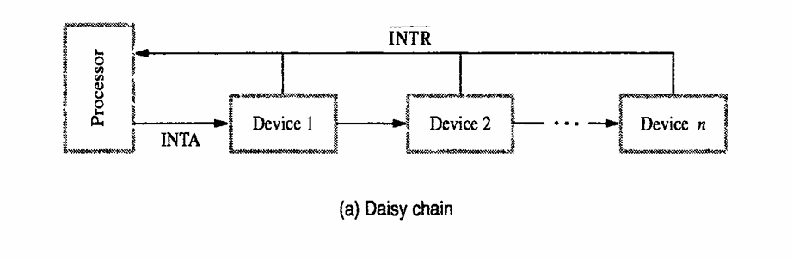
Machine Instructions and Programs Simultaneous Requests
For this a widely used scheme is to connect the devices to form a daisy chain as shown
Carl Hamacher, Zvonko Vranesic, Safwat Zaky, Computer Organization, 5th ed., McGraw Hill, 2002, Section 4.2

Slide 47
Machine Instructions and Programs Simultaneous Requests
the interrupt request line INTR is common to all devices
the interrupt acknowledge line INTA is connected in a daisy chain fashion , such that the INTA signal propagates serially through the devices
When INTR is active the processor responds by setting INTA to 1
Carl Hamacher, Zvonko Vranesic, Safwat Zaky, Computer Organization, 5th ed., McGraw Hill, 2002, Section 4.2

Slide 48
Machine Instructions and Programs Simultaneous Requests
This signal is received by device1 , and passes it to device2 only if it does not require any service.
If the Device 1 has pending request for interrupt, it blocks the INTA signal and proceeds to put its identifying code on the data lines
The device closest to cpu has higher priority
Carl Hamacher, Zvonko Vranesic, Safwat Zaky, Computer Organization, 5th ed., McGraw Hill, 2002, Section 4.2

Slide 49
Machine Instructions and Programs Simultaneous Requests
- The interrupt priority scheme is combined with daisy chain scheme as shown below
- Devices are organized in groups and each group is connected at a different priority level.
- Within a group devices are inter-connected in a daisy chain
Carl Hamacher, Zvonko Vranesic, Safwat Zaky, Computer Organization, 5th ed., McGraw Hill, 2002, Section 4.2

Slide 50
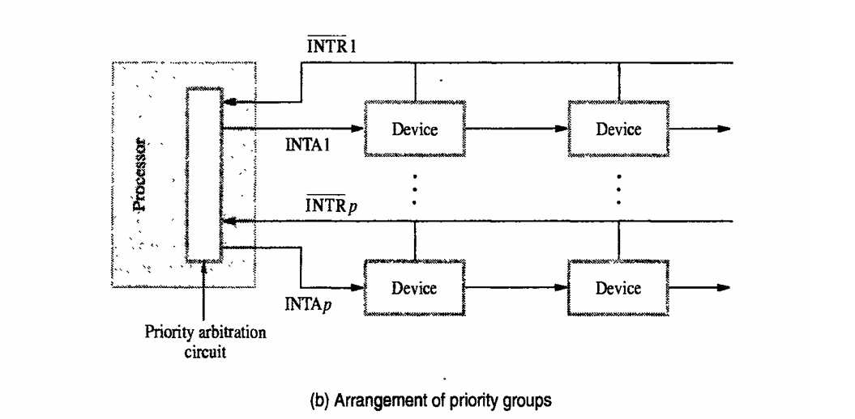
Machine Instructions and Programs Simultaneous Requests
Arrangement of priority groups as shown
Carl Hamacher, Zvonko Vranesic, Safwat Zaky, Computer Organization, 5th ed., McGraw Hill, 2002, Section 4.2

Slide 51
Machine Instructions and Programs Exceptions
Interrupts caused by interrupt-requests sent by I/O devices.
Interrupts could be used in many other situations where the execution of one program needs to be suspended and execution of another program needs to be started.
In general, the term exception is used to refer to any event that causes an interruption.
Interrupt-requests from I/O devices is one type of an exception.
Other types of exceptions are:
Recovery from errors
Debugging
Privilege exception
Carl Hamacher, Zvonko Vranesic, Safwat Zaky, Computer Organization, 5th ed., McGraw Hill, 2002, Section 4.2

Slide 52
Machine Instructions and Programs Exceptions
Many sources of errors in a processor. For example:
Error in the data stored.
Error during the execution of an instruction.
When such errors are detected, exception processing is initiated.
Processor takes the same steps as in the case of I/O interrupt-request.
It suspends the execution of the current program, and starts executing an exception-service routine.
Carl Hamacher, Zvonko Vranesic, Safwat Zaky, Computer Organization, 5th ed., McGraw Hill, 2002, Section 4.2

Slide 53
Machine Instructions and Programs Exceptions
Difference between handling I/O interrupt-request and handling exceptions due to errors:
In case of I/O interrupt-request, the processor usually completes the execution of an instruction in progress before branching to the interrupt-service routine.
In case of exception processing however, the execution of an instruction in progress usually cannot be completed.
Carl Hamacher, Zvonko Vranesic, Safwat Zaky, Computer Organization, 5th ed., McGraw Hill, 2002, Section 4.2

Slide 54
Machine Instructions and Programs Exceptions-helps programmer find errors in prog
Debugger uses exceptions to provide important features:
Trace,
Breakpoints.
Trace mode:
Exception occurs after the execution of every instruction.
Debugging program is used as the exception-service routine.
Breakpoints(Trap/software interrupt)
Exception occurs only at specific points selected by the user.
Debugging program is used as the exception-service routine.
Carl Hamacher, Zvonko Vranesic, Safwat Zaky, Computer Organization, 5th ed., McGraw Hill, 2002, Section 4.2

Slide 55
Machine Instructions and Programs Exceptions
Certain instructions can be executed only when the processor is in the supervisor mode. These are called privileged instructions.
If an attempt is made to execute a privileged instruction in the user mode, a privilege exception occurs.
Privilege exception causes:
Processor to switch to the supervisor mode,
Execution of an appropriate exception-servicing routine.
Carl Hamacher, Zvonko Vranesic, Safwat Zaky, Computer Organization, 5th ed., McGraw Hill, 2002, Section 4.2

Slide 56
MCQ
In a computer system, if the I/O devices and memory share the same address space, the system is said to use: a) Memory-mapped I/O b) Isolated I/O c) Program-controlled I/O d) Direct I/O
The CPU waits for a device to complete its operation by repeatedly checking its status register. This is called:
Interrupt-driven I/O
b) Direct Memory Access (DMA)
c) Polling
d) Channel I/O

Slide 57
MCQ
In a computer system, if the I/O devices and memory share the same address space, the system is said to use: a) Memory-mapped I/O b) Isolated I/O c) Program-controlled I/O d) Direct I/O
Answer: a) Memory-mapped I/O
The CPU waits for a device to complete its operation by repeatedly checking its status register. This is called:
Interrupt-driven I/O
b) Direct Memory Access (DMA)
c) Polling
d) Channel I/O
Answer: c) Polling

Slide 58
MCQ
The daisy chain priority scheme for handling multiple interrupts has the disadvantage that:
It requires more hardware lines
The device closest to the CPU has the lowest priority
The device farthest from the CPU has the lowest priority
All devices must generate interrupts simultaneously
The delay between the generation of an interrupt request and the execution of the corresponding ISR is known as
Cycle time
Instruction delay
Interrupt latency
Response time

Slide 59
MCQ
The daisy chain priority scheme for handling multiple interrupts has the disadvantage that:
It requires more hardware lines
The device closest to the CPU has the lowest priority
The device farthest from the CPU has the lowest priority
All devices must generate interrupts simultaneously
Answer: c) The device farthest from the CPU has the lowest priority
The delay between the generation of an interrupt request and the execution of the corresponding ISR is known as
Cycle time
Instruction delay
Interrupt latency
Response time
Answer: c) Interrupt latency

Slide 60
THANK YOU
Team DDCO
Department of Computer Science

